Slide 1

SHAP: EXPLAINING ANN
What are SHAPLEY values:
From game theory, to fairly distribute payoffs among players
In ML, they qunatify the contrinution of each feature by averaging over all possible permutations of feature combinations
Why use SHAP for ANNs:
Allow interpretation of different models, even “black-boxes”
Its transparency allows to understand why the model makes predictions
An unbiased method of assigning importance to features taking into account different possible interactions
07

Slide 2
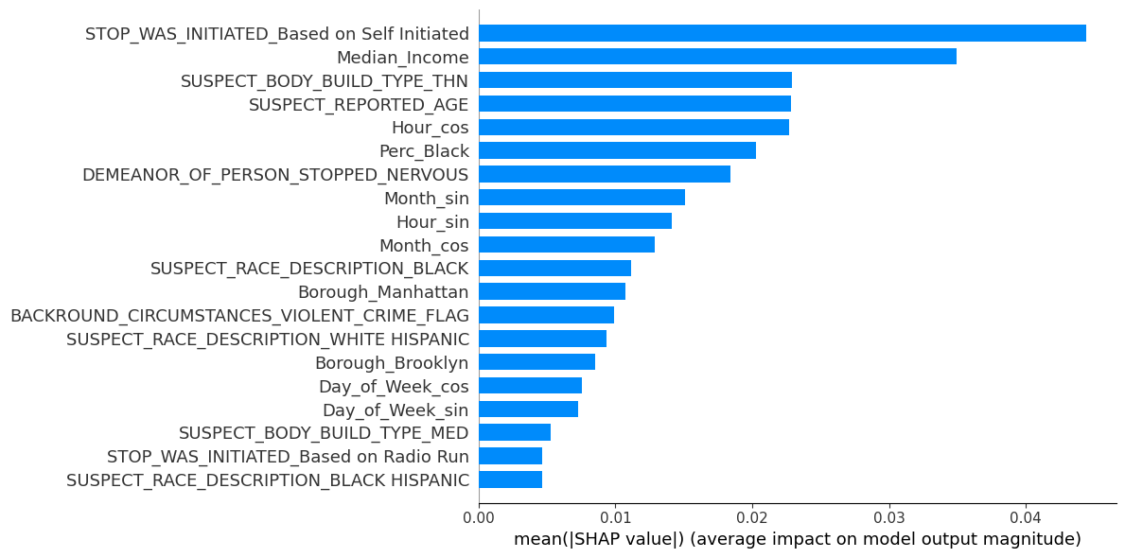
SHAP: UNJUSTIFIED STOPS
The top 20 features for unjustified search according to mean SHAP value

Slide 3
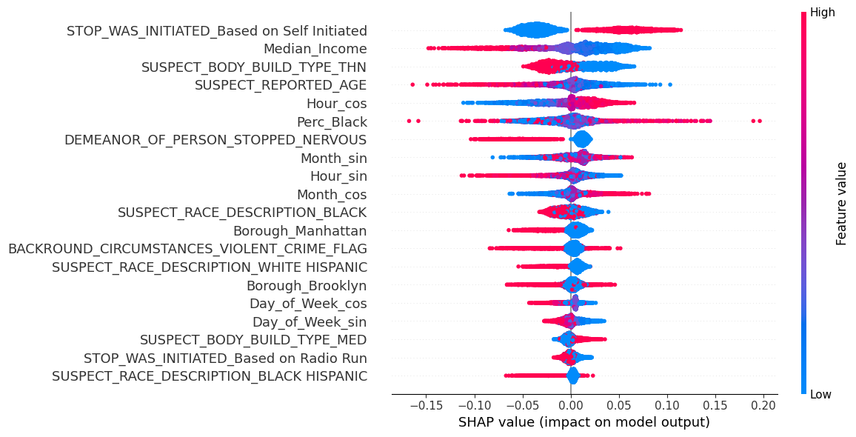
SHAP: UNJUSTIFIED STOPS
Top 20 features Beeswarm Plot
07

Slide 4
SHAP: UNJUSTIFIED STOPS
Interpertation of the Beeswarm plot for self initiated stops:
Self initiated stops (RED), have positive SHAP values:
Associated with unjustified stops.
Long tail of values with stronger magnitude.
Non self initiated stops (BLUE), have negative SHAP values:
Associated with unjustified stops.
Dense concentration with smaller values.
The difference in distribution is an indication of different interactions with the other features.
We can take a deeper look at how the different varaibles interact with each other by setting values of a feature and seeing how the rest of the shap values vary for the other features.
Ex: if we look at instnces where self initated = 1, what is the distribution of the other shap values.
07

Slide 5
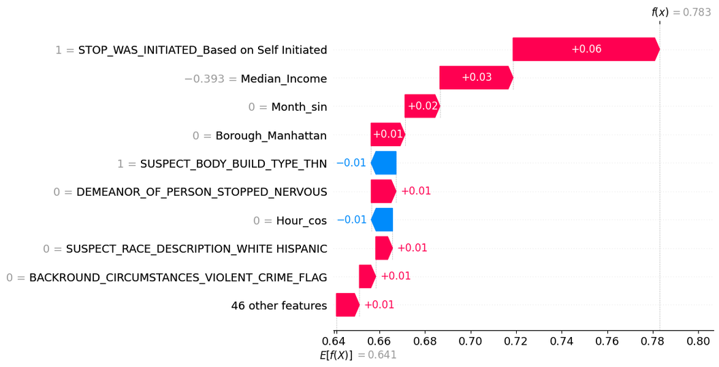
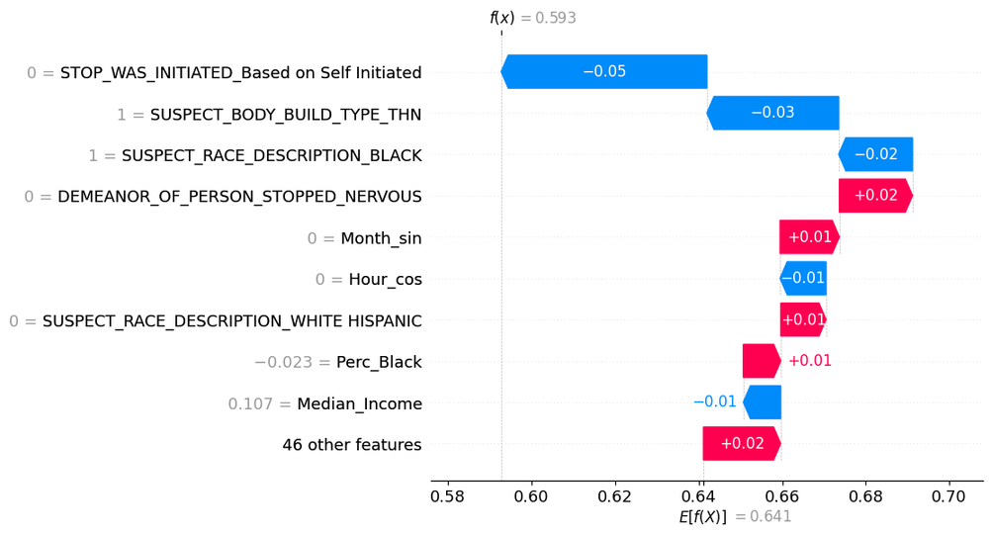
SHAP: UNJUSTIFIED STOPS
Waterfall plots allow us to look at the SHAP values of a specific instance:
Waterfall plot of the predicted unjustified stop typical profile
Waterfall plot of the predicted justified stop typical profile
07

Slide 6
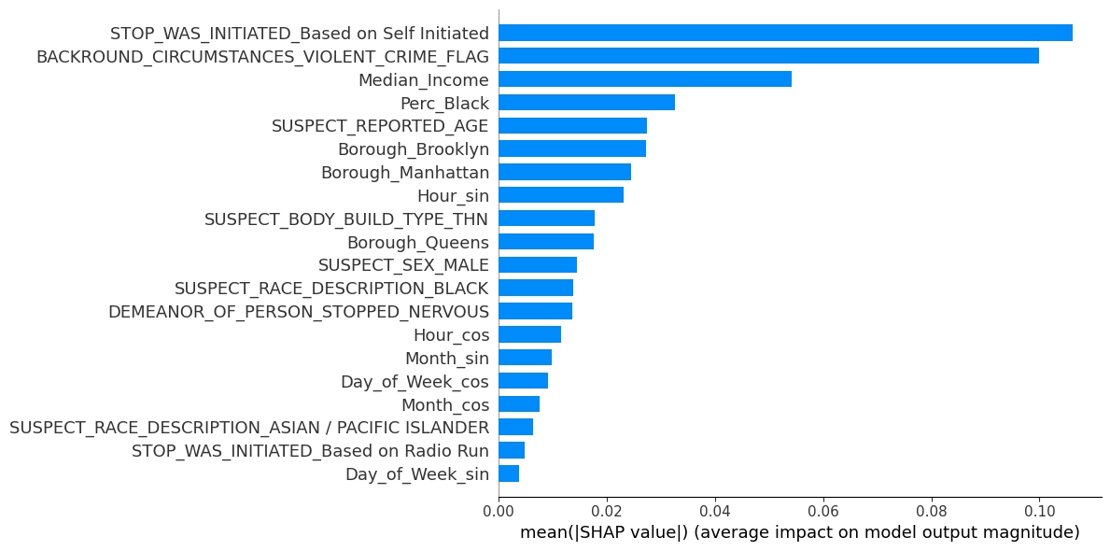
SHAP: UNJUSTIFIED FRISK
The top 20 features for unjustified frisk according to mean SHAP value
07

Slide 7
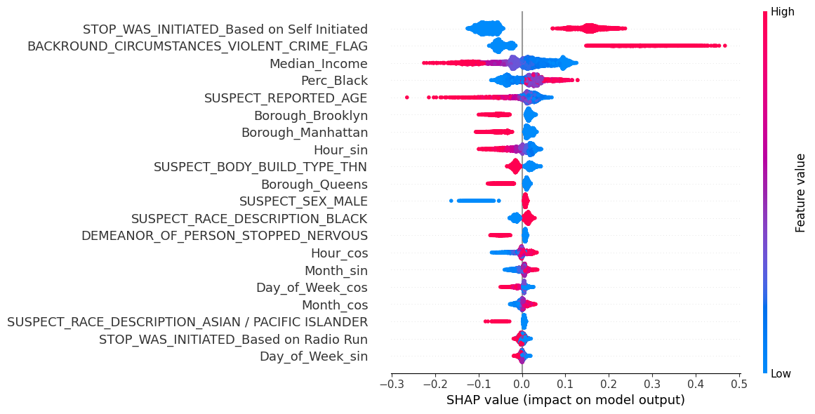
SHAP: UNJUSTIFIED FRISK
Top 20 features Beeswarm Plot
07

Slide 8
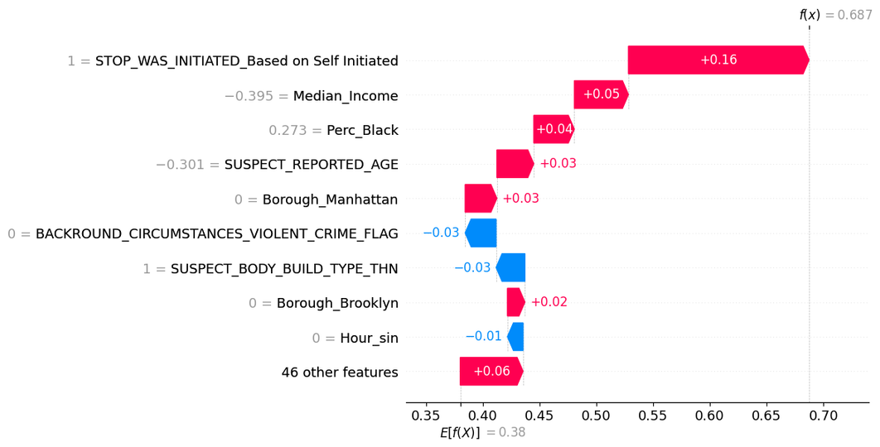
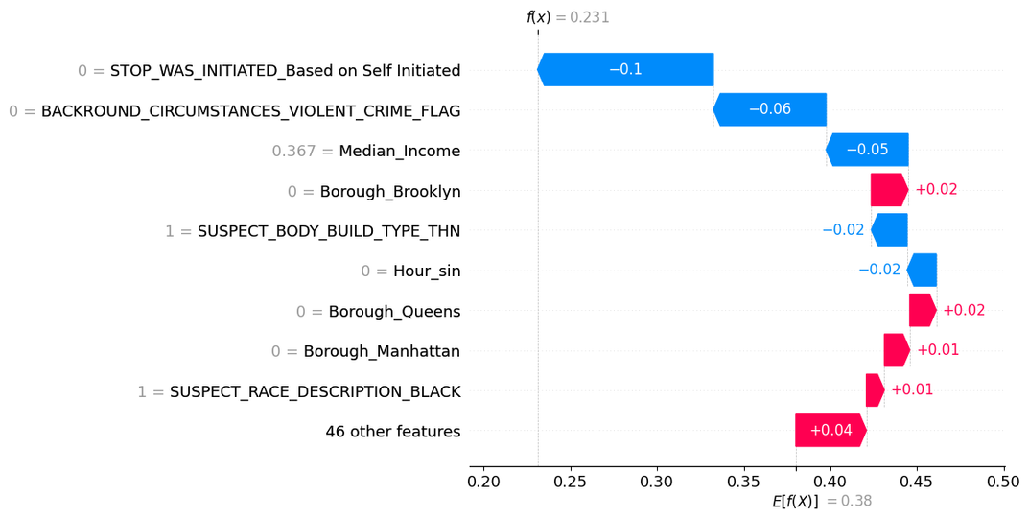
SHAP: UNJUSTIFIED FRISK
Waterfall plots allow us to look at the SHAP values of a specific instance:
Waterfall plot of the predicted unjustified frisk typical profile
Waterfall plot of the predicted justified frisk typical profile
07

Slide 9
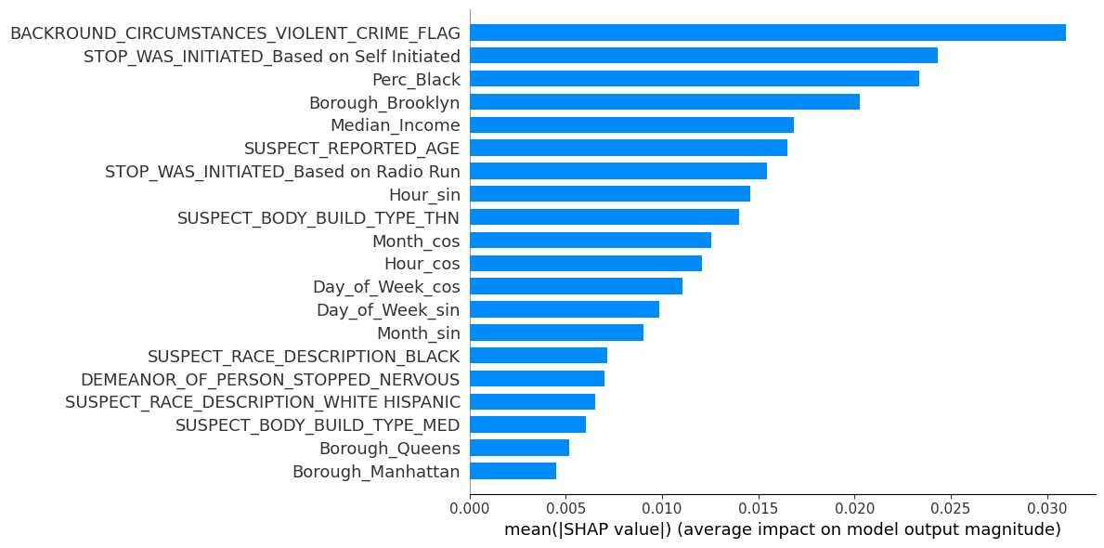
SHAP: UNJUSTIFIED SEARCH
The top 20 features for unjustified search according to mean SHAP value
07

Slide 10
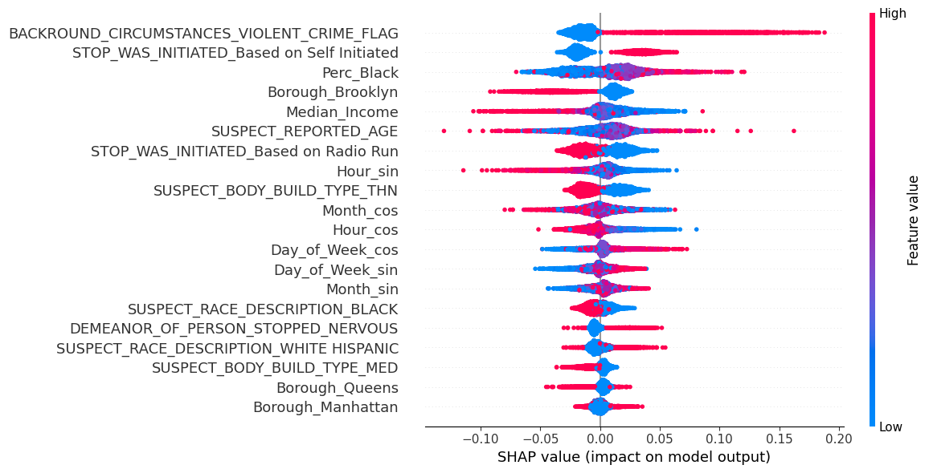
SHAP: UNJUSTIFIED FRISK
Top 20 features Beeswarm Plot
07

Slide 11
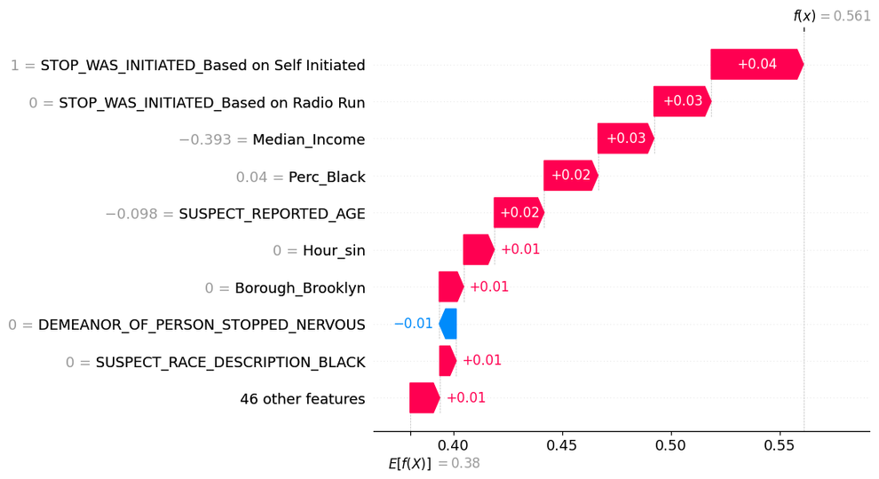
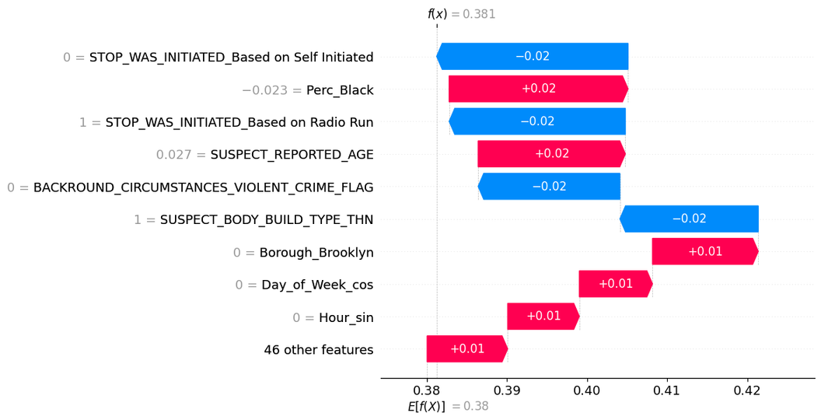
SHAP: UNJUSTIFIED FRISK
Waterfall plots allow us to look at the SHAP values of a specific instance:
Waterfall plot of the predicted unjustified search typical profile
Waterfall plot of the predicted justified serch typical profile
07

Slide 12
SHAP: COMPARISON BETWEEN TARGETS
From the summary plots:
The top predictors are similar for each of the target variables
especially the strongest
The average magnitude of SHAP values are much smaller for unjustified search compared to the other targets
From the profile plots:
The profiles are similar between the justified and unjustified for all of the target varaibles
especially for the unjustified
Limitations and acknowledgements of this approach:
The average of each feature was computed by including all predicted observations
can investigate the different profiles between true and false predictions
For binary variables selected the most likely value according to the average
does no necessarily reflect a true profile
reflected by the justified stop profile still having a value over 0.5
07

Slide 13

IMPLICATIONS FOR LAW ENFORCEMENT AGENCIES
Need for age-sensitive training to reduce bias against younger individuals.
Implement community-based policing strategies in lower-income areas.
Review and revise protocols for self-initiated stops to reduce unjustified actions.
Enhance diversity and inclusion training to address racial biases.
Develop data-driven performance metrics that discourage unjustified actions.
Implement body-worn cameras and regular audits to increase accountability.
Create specialized units for youth engagement and community relations.
Establish an early warning system to identify officers with patterns of unjustified actions.

